Slide 1
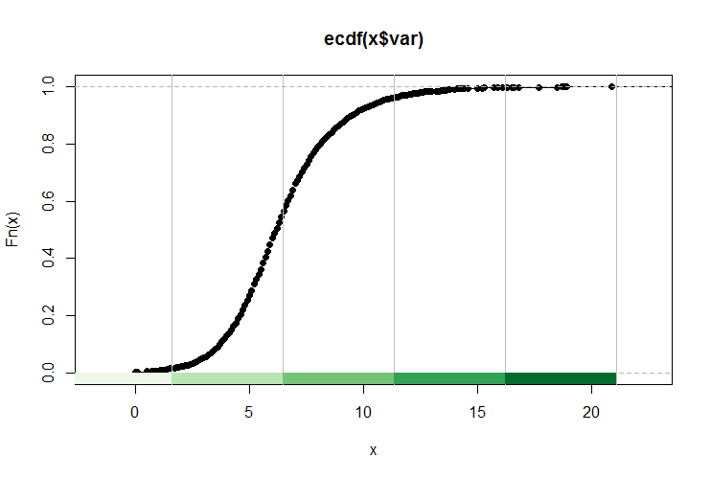
Week 9:Normality testing; Chi-square; Non-parametric tests
Geog4300: Shannon

Slide 2
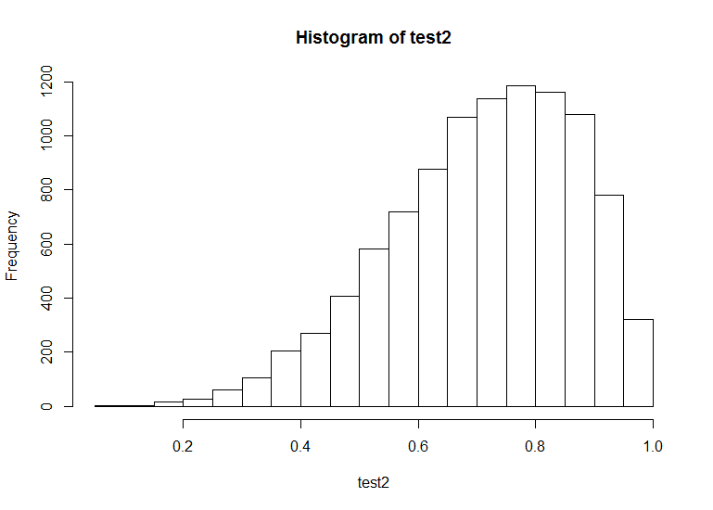
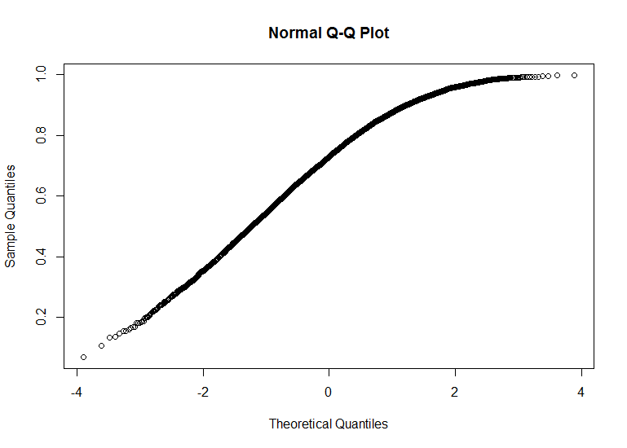
How do we assess normality?
Histograms
QQ plots
Normality tests
Notes:
Alternative hypothesis is usually what you’re trying to prove.

Slide 3
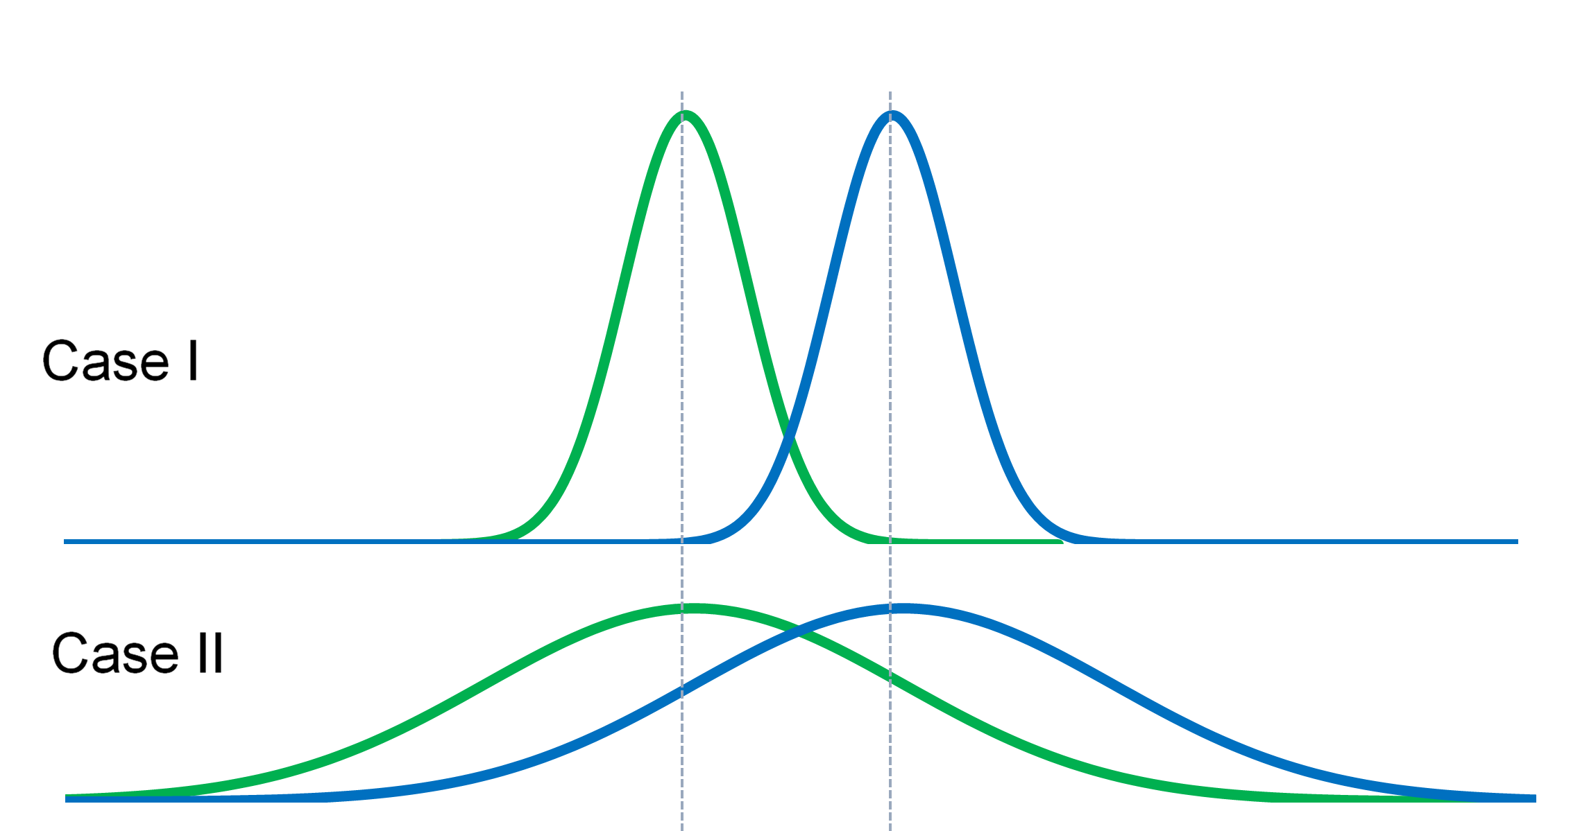
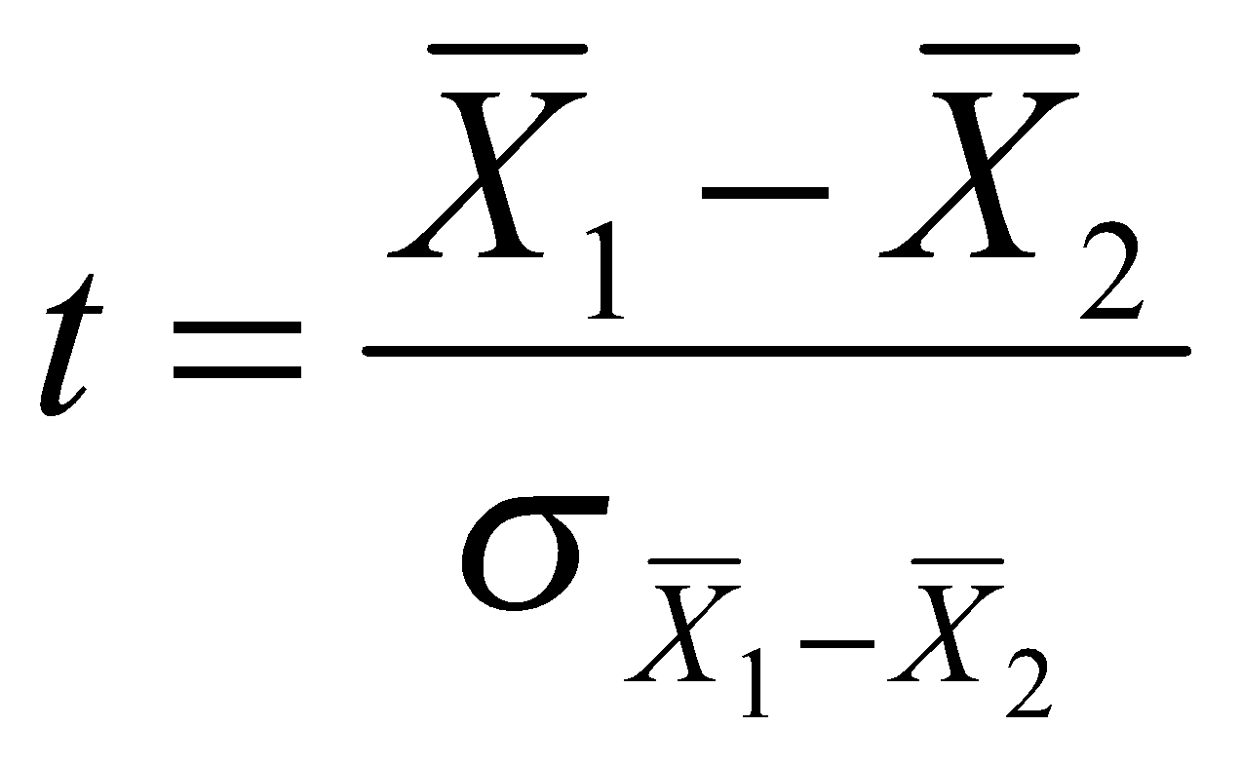
Two sample t-tests
Instead of comparing one sample against a predetermined mean, identifying difference between two samples
Notes:
Alternative hypothesis is usually what you’re trying to prove.

Slide 4
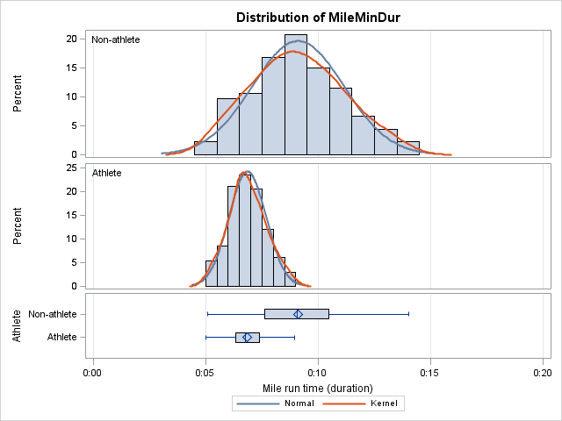
Two sample t-tests
Key question #1: Is the variance in both samples even or uneven?
Notes:
Alternative hypothesis is usually what you’re trying to prove.

Slide 5
Key question #1: Is the variance in both samples even or uneven?
Look at the 2019 census data and compute the standard deviation for two categories of racial classification. How do those compare?
Variance = Standard deviation^2
Notes:
Alternative hypothesis is usually what you’re trying to prove.

Slide 6
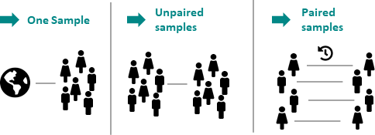
Two sample t-tests
Key question #2: Are the samples independent or paired?
Notes:
Alternative hypothesis is usually what you’re trying to prove.

Slide 7
Key question #2: Are the samples independent or paired?
On a sheet of paper, write down two research questions for your area of interest. One should use two independent samples and one should use a paired sample.
Notes:
Alternative hypothesis is usually what you’re trying to prove.

Slide 8
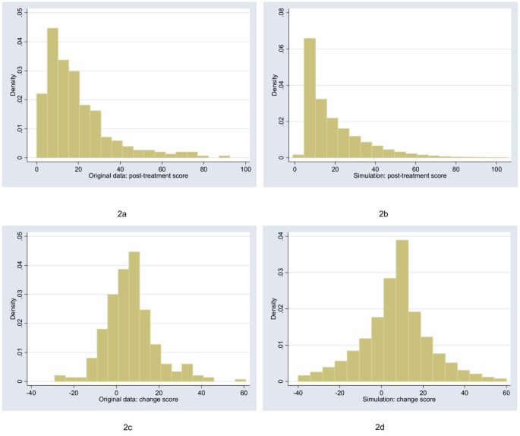
Two sample t-tests
Number of named Atlantic tropical storms, years
Key question #3: Are the samples parametric (normal) or non-parametric?
El Nino | La Nina
0 (1.5) | 4 (12)
5 (15) | 4 (12)
1 (3.5) | 12 (21)
3 (9) | 2 (6.5)
4 (12) | 17 (22)
1 (3.5) | 7 (18)
2 (6.5) | 6 (16.5)
2 (6.5) | 10 (20)
0 (1.5) | 4 (12)
2 (6.5) | 8 (19)
4 (12) | 6 (16.5)
W₁ = 77.5 W₂ = 175.5
Notes:
Alternative hypothesis is usually what you’re trying to prove.

Slide 9
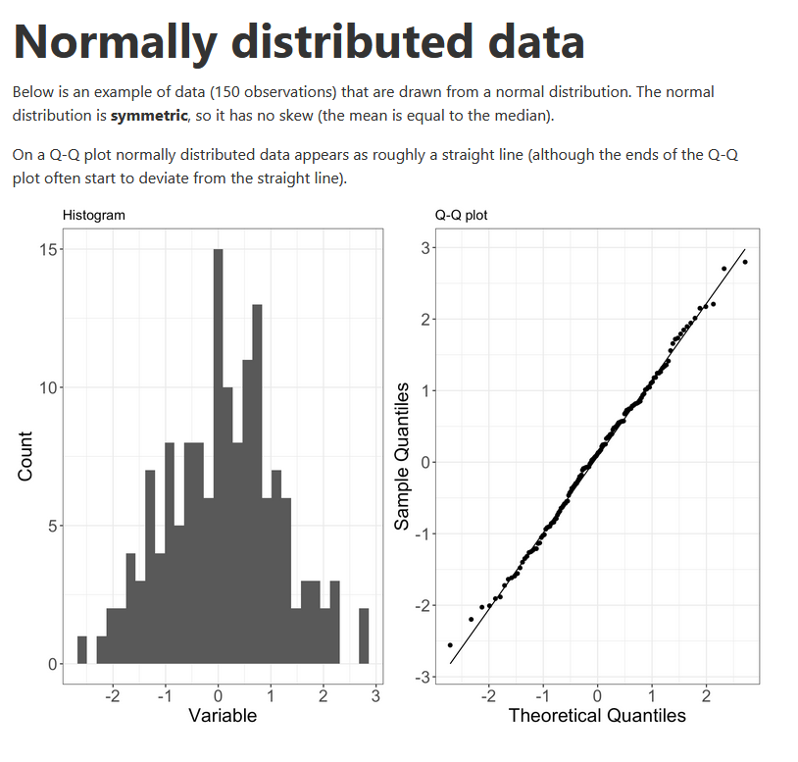
How do we assess normality?
Histograms
QQ plots
Normality tests
https://www.ucd.ie/ecomodel/Resources/QQplots_WebVersion.html
Notes:
Alternative hypothesis is usually what you’re trying to prove.

Slide 10
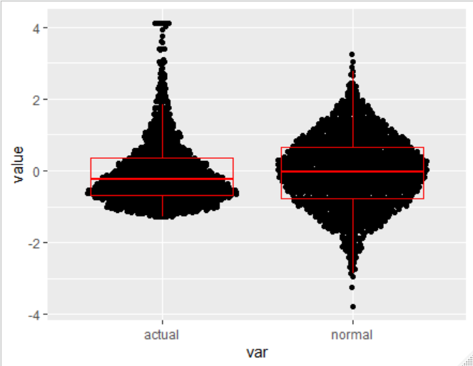
QQ plots
90th percentile
75th percentile
25th percentile
10th percentile
Notes:
Alternative hypothesis is usually what you’re trying to prove.

Slide 11
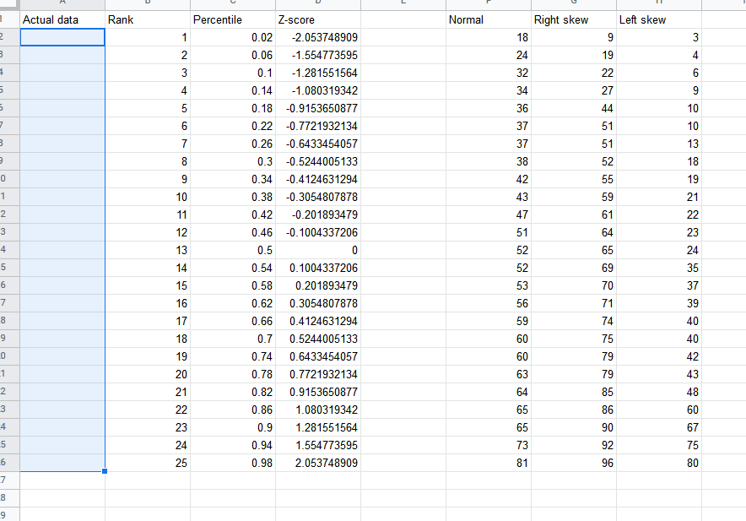
Let’s build a QQ plot
https://docs.google.com/spreadsheets/d/1GJ2QEsMB5fKlB0vOXXuB5s54ShSpeCJzB2Ph-SbmtQA/copy?usp=sharing
Notes:
Alternative hypothesis is usually what you’re trying to prove.

Slide 12
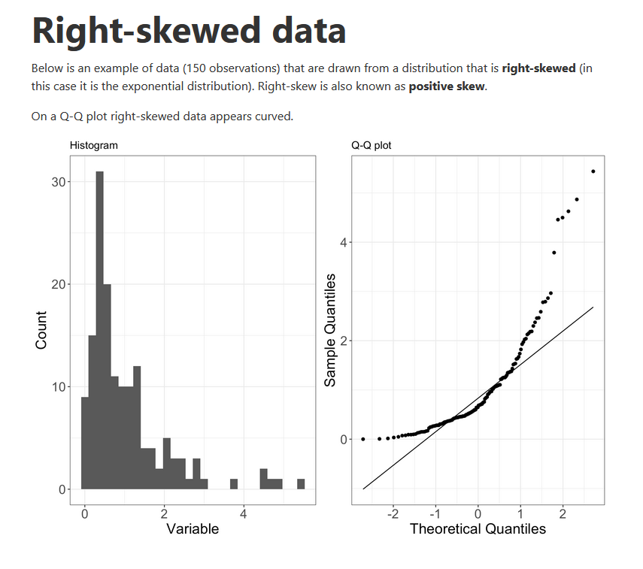
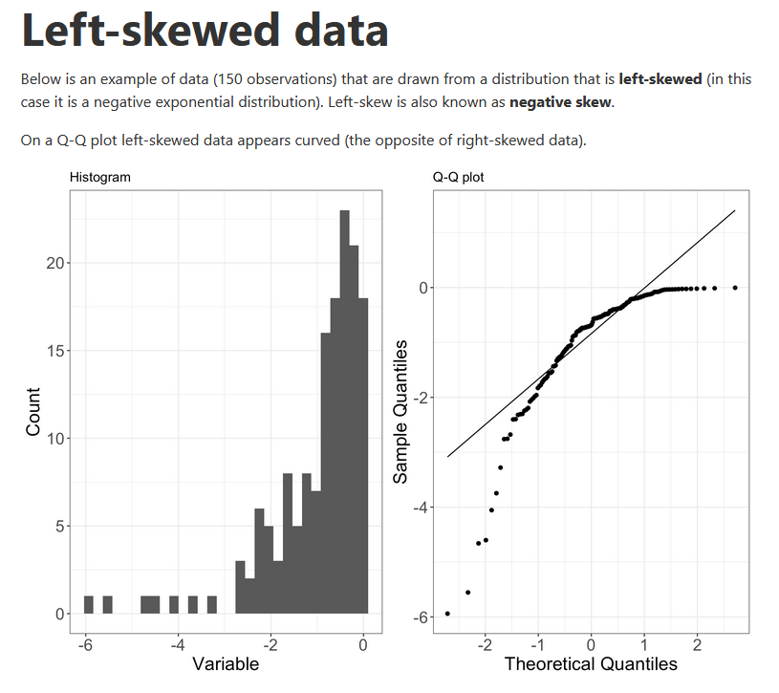
More on QQ plot shapes
https://www.ucd.ie/ecomodel/Resources/QQplots_WebVersion.html
Notes:
Alternative hypothesis is usually what you’re trying to prove.

Slide 13
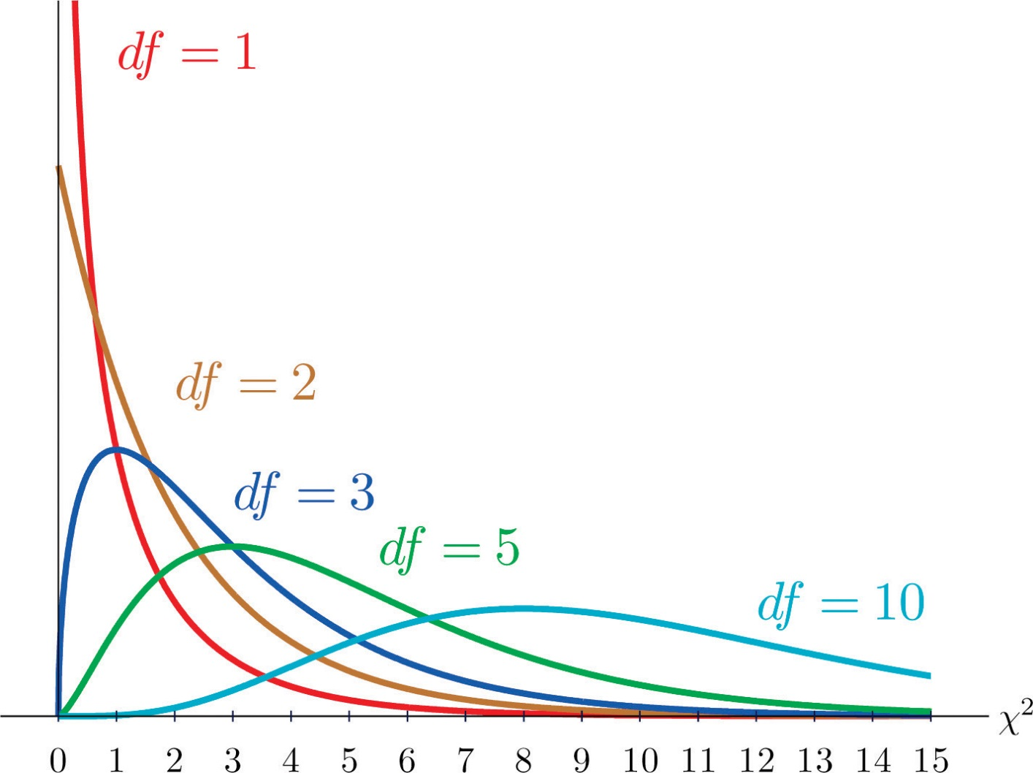
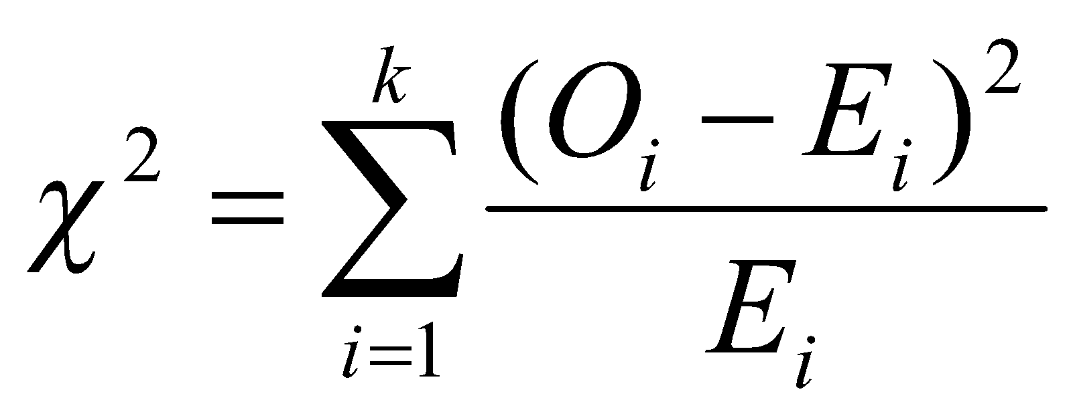
Chi-square tests
For two categorical variables
O_{i} = Observed value for observation i
E_{i} = Expected value for observation i
k = Number of observations in all groups
Notes:
Alternative hypothesis is usually what you’re trying to prove.

Slide 14

An example
Does your football team tell you something
about your Thanksgiving meal preference
(dark/white meat or tofurkey)?
What are the independent and dependent variable?
Independent: Football team (Nominal)
Dependent: Meal choice (Nominal)
Notes:
Alternative hypothesis is usually what you’re trying to prove.

Slide 15
ESPN surveyed 85 football fans…
 | White meat | Dark meat | Tofu-rkey | TOTAL
Lions | 15 | 25 | 3 | 43
Cowboys | 25 | 10 | 7 | 42
TOTAL | 40 | 35 | 10 | 85
This contingency table shows turkey preference as a function of (“contingent upon”) team preference.
Degrees of freedom = (#rows -1)*(#cols-1) = (2-1)(3-1) = 2
Notes:
Alternative hypothesis is usually what you’re trying to prove.

Slide 16
Calculating expected values
 | White meat | Dark meat | Tofu-rkey | TOTAL
Lions | =.47 * 43 = 20.2 | =.41 * 43 = 17.7 | =.12 * 43 = 5.1 | 43
Cowboys | =.47 * 42 = 19.8 | =.41 * 42 = 17.3 | =.12 * 42 = 4.9 | 42
TOTAL | 40 (47%) | 35 (41%) | 10 (12%) | 85
Notes:
Alternative hypothesis is usually what you’re trying to prove.

Slide 17
What’s the chi-square statistic?
 | White meat | Dark meat | Tofu-rkey | TOTAL
Lions | O = 15 E = 20.2 | O = 25 E = 17.7 | O = 3 E = 5.1 | 43
Cowboys | O = 25 E = 19.8 | O = 10 E = 17.3 | O = 7 E = 4.9 | 42
TOTAL | 40 (47%) | 35 (41%) | 10 (12%) | 85
χ² = (15-20.2)² / 20.2 + … (7-4.9)² / 4.9
Critical value for 2 degrees of freedom is 5.99
Notes:
Alternative hypothesis is usually what you’re trying to prove.

Slide 18
You try it!
A survey was done of Manhattan residents to see if their most common transportation method was related to their income. Here are the results:
 | Car | Transit | Walk/bike | Total
Low income | 58 | 21 | 36 | 115
Moderate income | 199 | 49 | 64 | 312
High income | 205 | 32 | 29 | 266
Total | 462 | 102 | 129 | 693
Using a chi-square test, check to see if these results show a difference between these groups. You may want to enter this table in Excel to run this analysis.
Notes:
Alternative hypothesis is usually what you’re trying to prove.

Slide 19
Writing up results
Results of statistical analysis generally focus on direction, magnitude, and significance.
For a chi-square test, calculate the percentage of each income group in each transit type. Then write a paragraph that summarizes your findings. What pattern do you see of higher or lower rates? What is the magnitude of the key differences? Is it statistically significant?
 | Car | Transit | Walk/bike | Total
Low income | 58 | 21 | 36 | 115
Moderate income | 199 | 49 | 64 | 312
High income | 205 | 32 | 29 | 266
Total | 462 | 102 | 129 | 693
Notes:
Alternative hypothesis is usually what you’re trying to prove.

